Slide 1

SHRI VAISHNAV VIDYAPEETH VISHWAVIDYALAYA ,INDORE
SHRI VAISHNAV INSTITUTE OF INFORMATION TECHNOLOGY
DEPARTMENT OF INFORMATION TECHNOLOGY
SUBJECT:-IOT PROJECT
SEM/Year :- VI/3rd year, CLASS:-IT-B
SUBMIT TO:- PROF. RICHA JAIN SUBMIT BY:- RISHABH RAJ [19100BTIT06601] ( group leader)
RISHABH [19100BTIT06599]
PRASHANT VISHVKRMA [19100BTIT06591]
SOHIL JAIN [191000BTIT06619]
RISHABH RATHORE [19100BTIT06602]

Slide 2
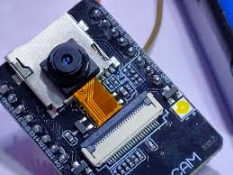
TOPIC:- SPY CAMERA WITH THIN OBJECT
Objective:- The project objective is to increase the intelligence of the video surveillance system , detect all the irregular movement within the area or a selective person and identification of target without their knowledge.

Slide 3
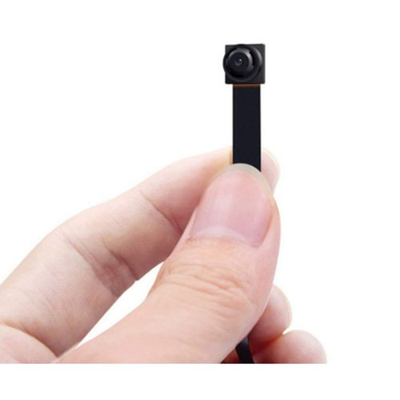
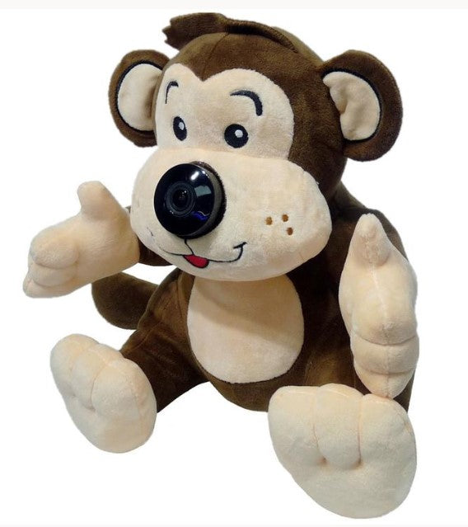

What we need to make this project
Spy camera:-
Any toys or flower pot:-
Any Android phone
Battery
SD Card

Slide 4
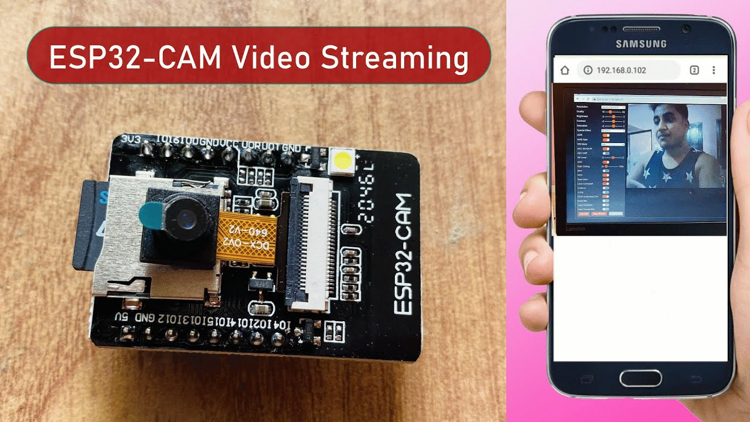
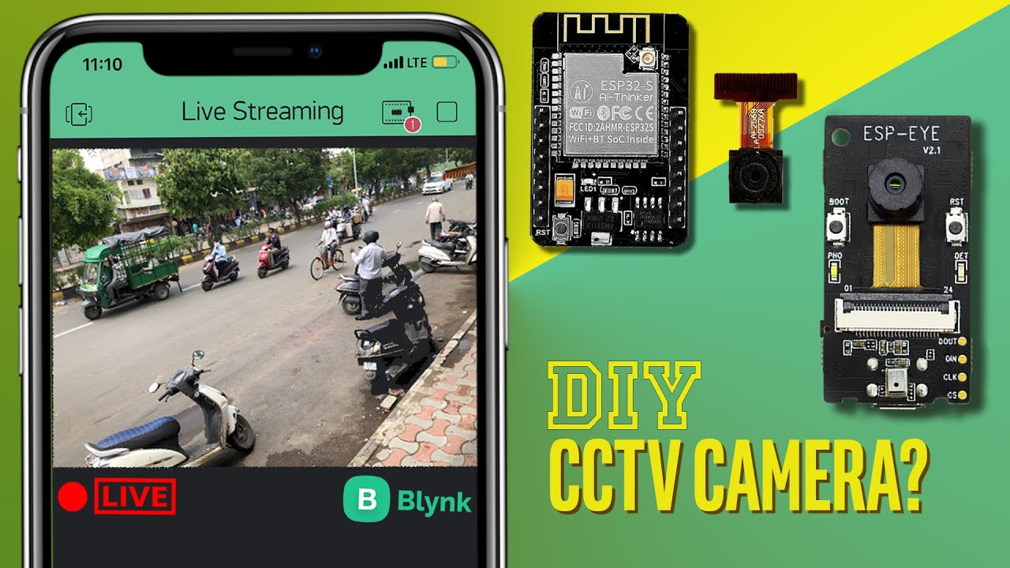
If your camera is not in the list of available WIFI’s, hold the reset button for 4 seconds an then wait another 30 sec and it should show up.
On the main screen in the APP we have record button, snapshot and talkback but that dosen’t work with this camera since there is no speaker, only a microphone.
You have mute and quick access to Wi Fi settings and then we have buttons for flipping the screen. On the top we can change the image quality, turn on night vision and change brightness and contrast.

Slide 5
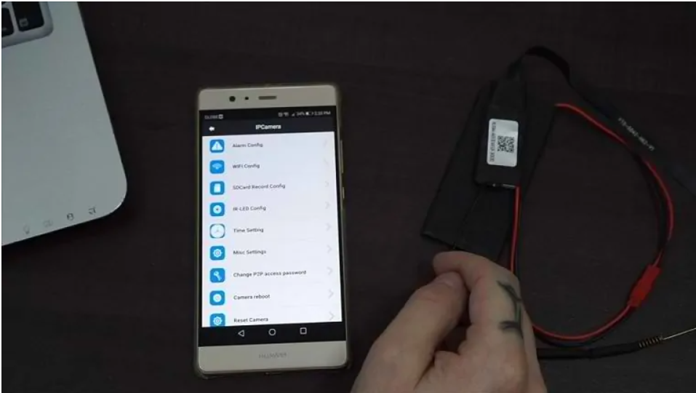
If we click on the settings symbol in the top right corner we have all the important settings here. In Alarm Config we can change the sensitivity of motion detection, you can add an alarm schedule, turn on/off warning tone and change what alarm interval as well as turn on or off push notifications.
If we go back out and into SD Record Config, we can change when you want the camera to save on the SD card as well as what resolution. This is also where you format the Sd card. What else, you can reboot and reset the camera in here as well.

Slide 6
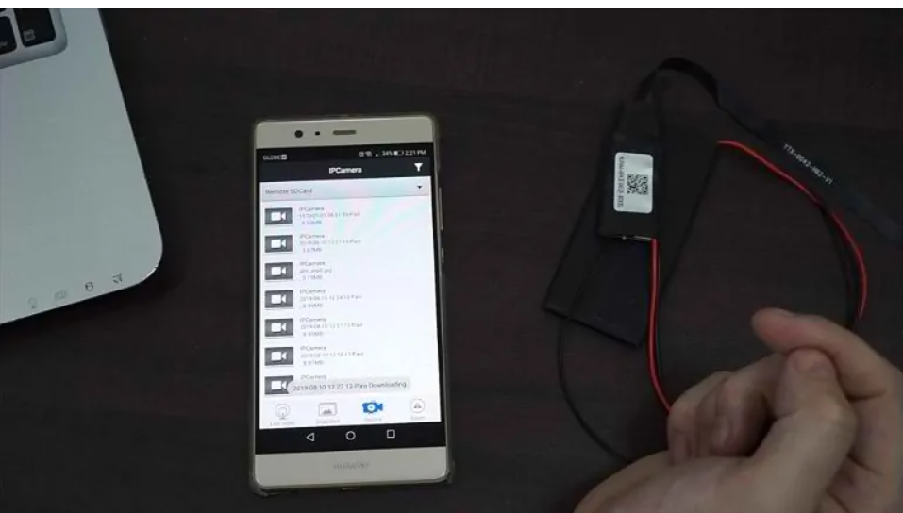
If we go back out on the main page, we will find our snapshots, recordings and alarm notifications. You can also access the SD card recordings here and to do that we go to, record, then we choose remote sd card. You can watch the clips here but if you want to download them to your phone you click on download and then it should start download the file.

Slide 7
Thank You

